Slide 1

A more efficient real estate market

Slide 2
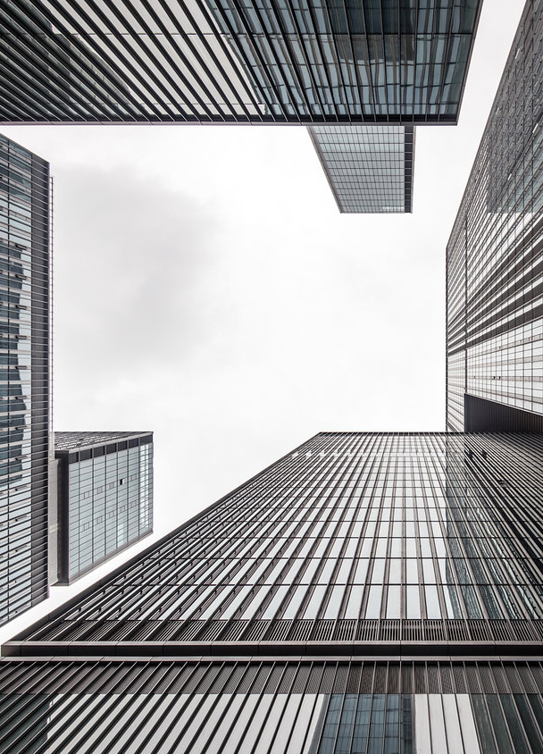
Challenge: Rapid Growth of Commercial Real Estate
China
Annual Investment: 500 BIL ¥
Hangzhou
Annual Growth: 19%
Vacancy Rate: 17%
Grow in non-prime areas: 83%
(incl. Wanxiang Innovation City 万向创新聚能城)

Slide 3






Solution: Rental Lease Contracts as Digital Assets
Split Asset
1st Leaser
1st Leaser
Owner
Split Asset
2nd Leaser

Slide 4
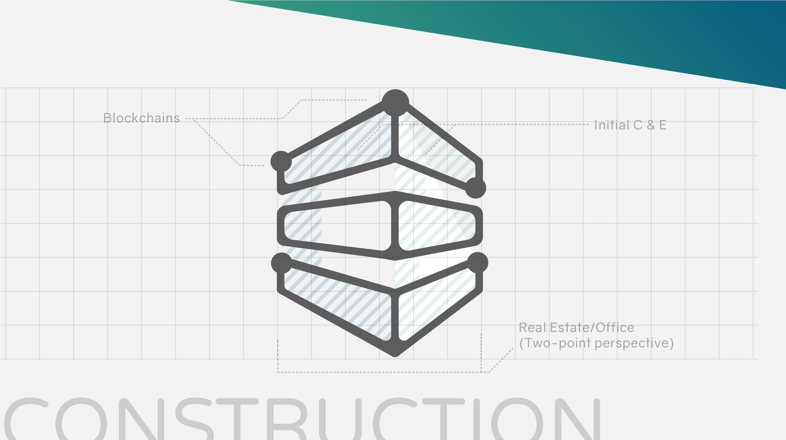
Live Demo: Digital Asset creation

Slide 5
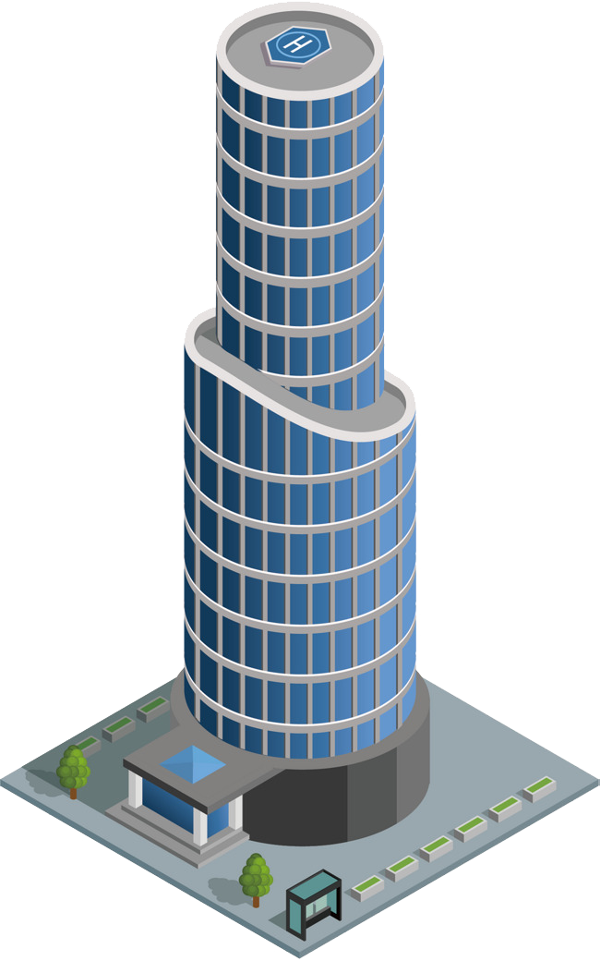





Architecture: Digital asset connected to real world assets
Data Name
Price per M2
Price
Status (V, O, S)
Lease start/end
Parent ID Deposit
Payment dates
Leaser rating
Etc …
ERC721 token Digital Asset
Government
Smart Cities
Frontend
Interaction
ERC20 token for incentive

Slide 6
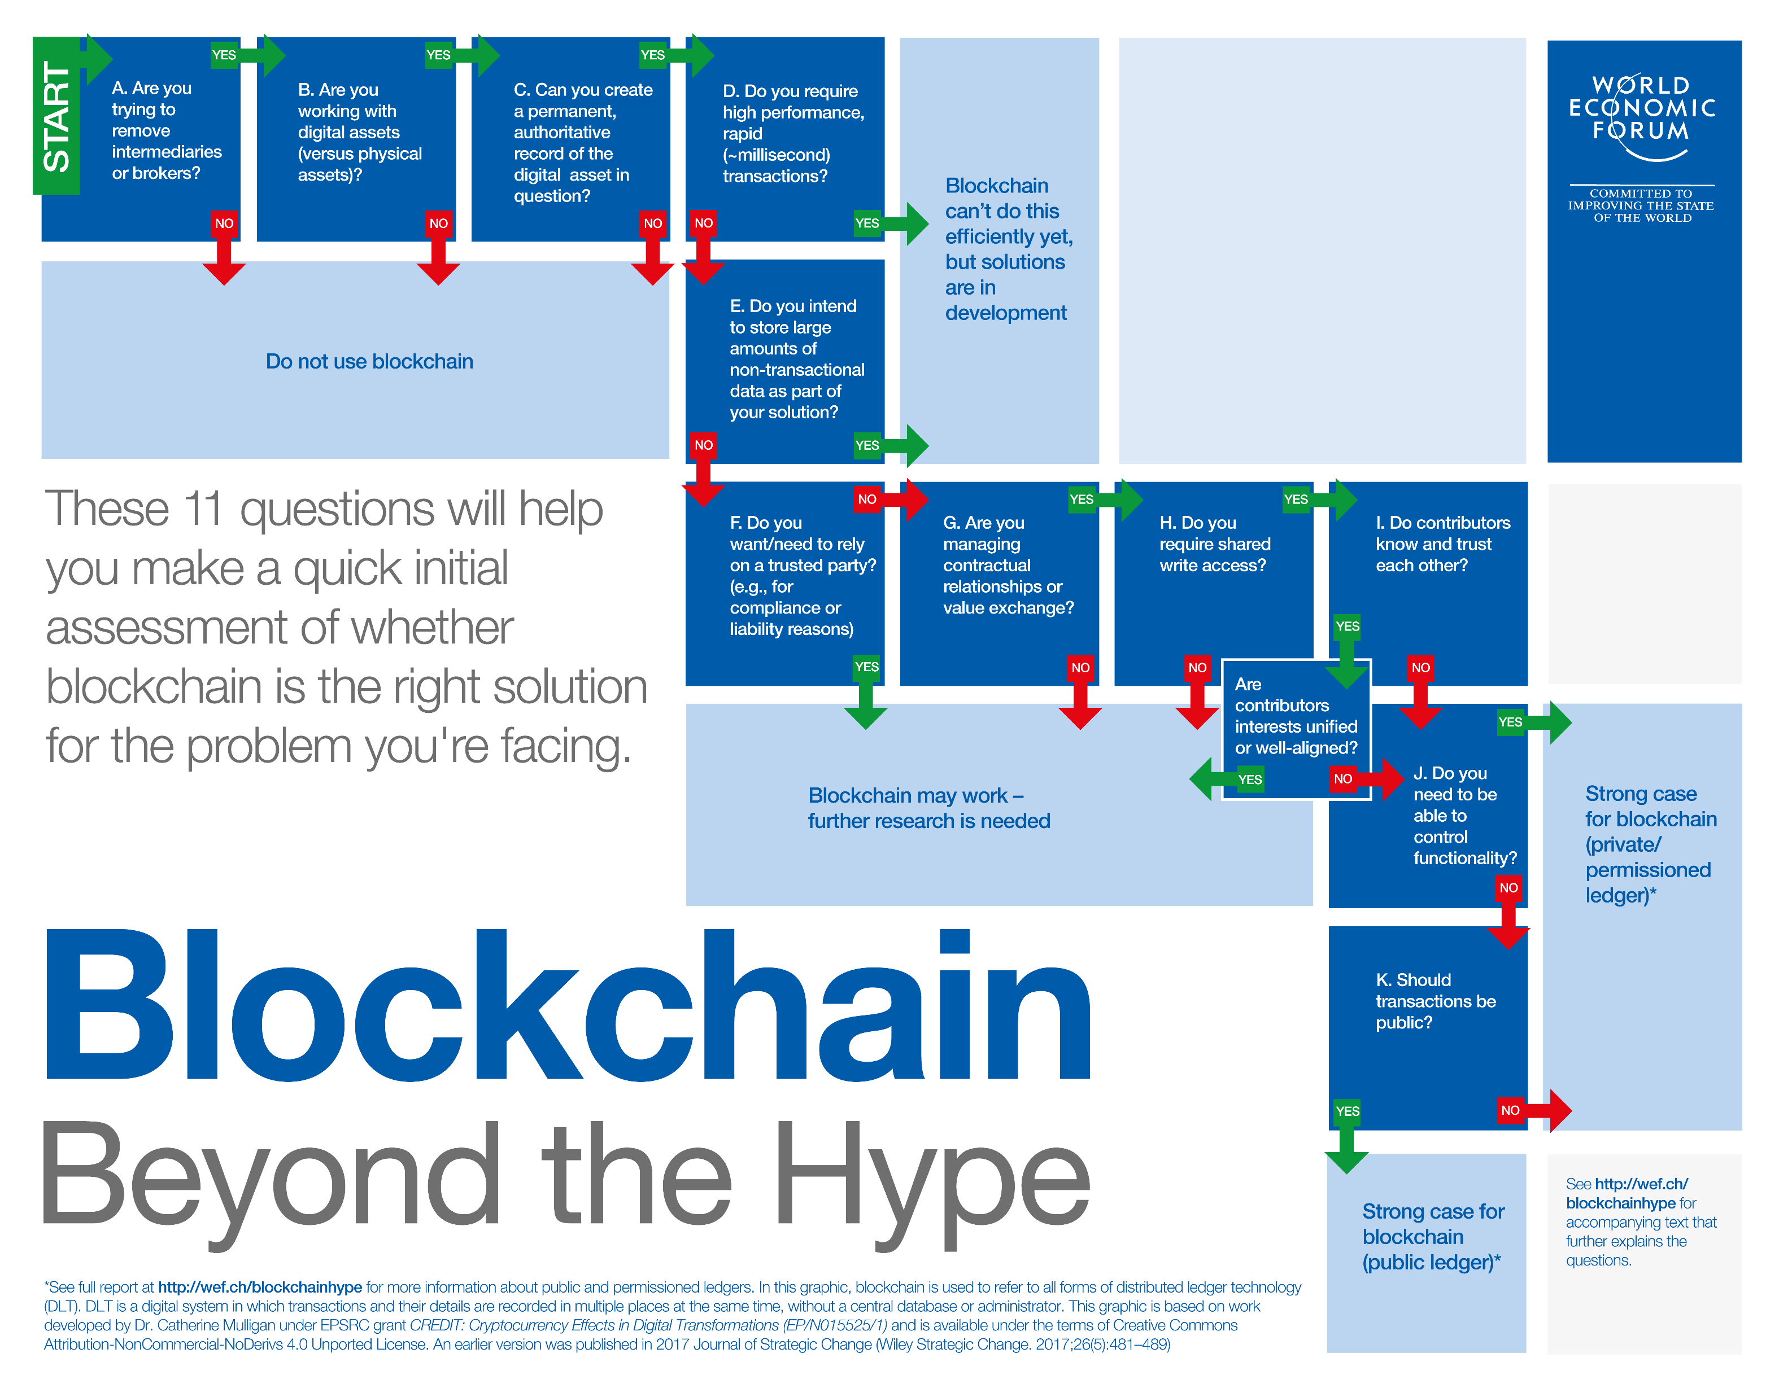
Do we need a Blockchain for that?
The Xiong’an New Area（雄安新区）
is experimenting with similar tech
Solving the illiquidity problem for commercial real estate
A more efficient secondary markets
Better control of common space
Budget management improvement

Slide 7


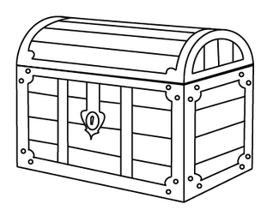
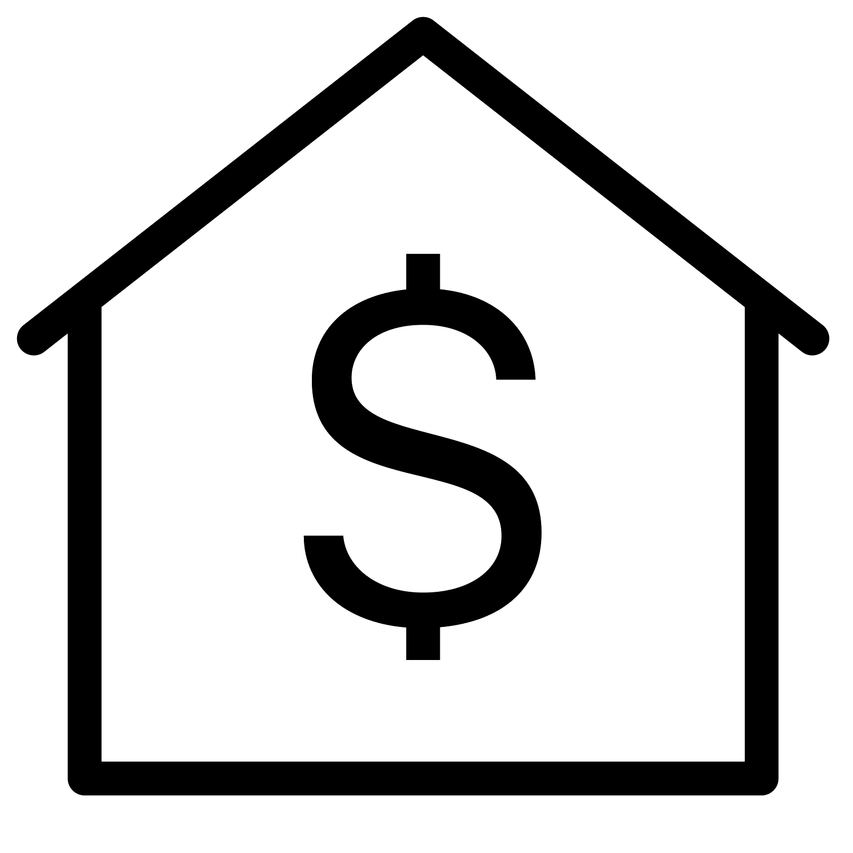
Potential Token Economic models
Work funded DAO model
Self funded funded DAO model
Freemium secondary market

Slide 8
The Chain Estate Rock Stars
Andrey Bogomolov – Real estate Hacker
Ted Wu – Alround superstar
Guesswhat – Research Boss Amadeo Brands – Coin slayer

Slide 9
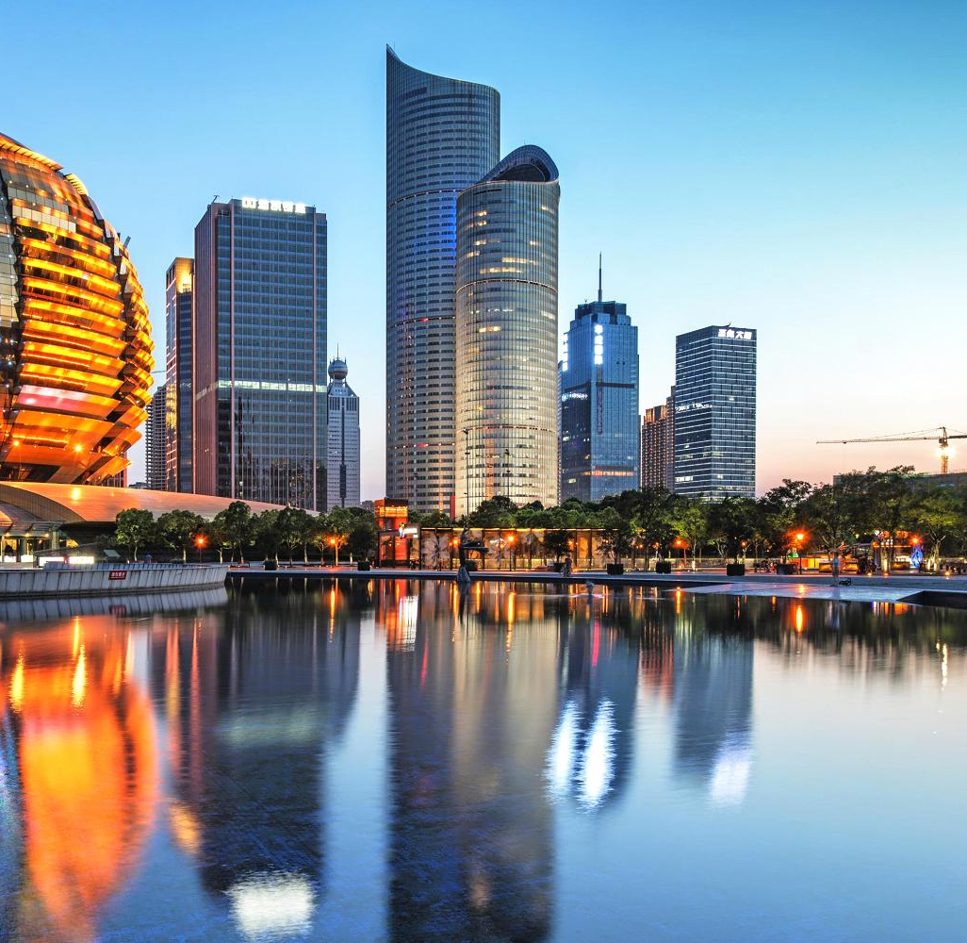
Thank you Any Questions?

Slide 10




Competitors in Blockchain with Real Estate
Example:

Slide 11
Advantages For New developing Areas
Potential Token Economic models
New developing regions like
The Xiong’an New Area（雄安新区）
has already using this tech
for residential housing(1).
By making digitalizing leasing process
we help to accelerate the grows of new
cities and companies.
Transform our solution into a standard
for commercial real estate.
Fortum thing to connect to government.
Expend to the external online markets.

